Slide 1

Getting Started with MATLAB
2. General MATLAB Functions, Matrices and Determinants
Vahid Naeini
E-mail: naeini.v@gmail.com

Slide 2


Vectors and Matrices
Vector
formerly Victor Perkins,
main antagonist of “Despicable Me”
Directors: Pierre Coffin, Chris Renaud
Matrix
A 1999 American science fiction action film
Writer & Director: Wachowski brothers (?)
Getting Started with MATLAB / 2. General MATLAB Functions, Matrices and Determinants/ V.Naeini

Slide 3
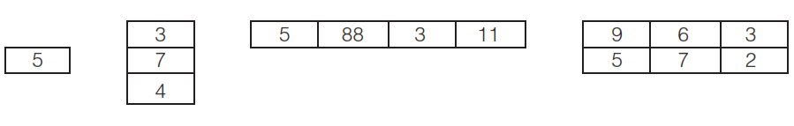
Vectors and Matrices
The dimensions of a matrix are r x c
r is the number of rows
c is the number of columns
Scalar column vector row vector matrix
Getting Started with MATLAB / 2. General MATLAB Functions, Matrices and Determinants/ V.Naeini

Slide 4
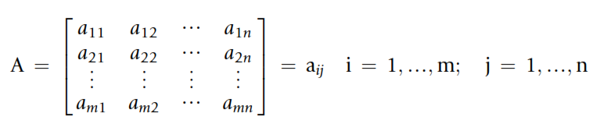
Vectors and Matrices
The general form of an m x n matrix:
Getting Started with MATLAB / 2. General MATLAB Functions, Matrices and Determinants/ V.Naeini

Slide 5
Vectors and Matrices
Row Vectors
>> v=[1 2 3 4]
>> v = [1,2,3,4]
Getting Started with MATLAB / 2. General MATLAB Functions, Matrices and Determinants/ V.Naeini

Slide 6
Vectors and Matrices
The Colon Operator (:) and Linspace Function
>> vec = 1:5
>> nv = 1:2:9
>> 1:2:6 %????
ans =
1 3 5
>> 9:-2:1
Getting Started with MATLAB / 2. General MATLAB Functions, Matrices and Determinants/ V.Naeini

Slide 7
Vectors and Matrices
>> ls = linspace(3,15,5)
>> logspace(x,y,n)
inclusive range from 10^x to 10^y. (n parts)
>> logspace(1,5,5)
Getting Started with MATLAB / 2. General MATLAB Functions, Matrices and Determinants/ V.Naeini

Slide 8
Vectors and Matrices
>> newvec = [nv ls] %add two row vect.
Getting Started with MATLAB / 2. General MATLAB Functions, Matrices and Determinants/ V.Naeini

Slide 9
Vectors and Matrices
Referring to and Modifying Elements
>> vec1 = [ 1 2 3 5 6 7 8]
>> vec1(5)
ans=
6
>> vec1(2:4)
ans=
2 3 5
Getting Started with MATLAB / 2. General MATLAB Functions, Matrices and Determinants/ V.Naeini

Slide 10
Vectors and Matrices
>> b = newvec([1 6 3])
ans=
1 7 3
>> b(2)
ans =
7
Getting Started with MATLAB / 2. General MATLAB Functions, Matrices and Determinants/ V.Naeini

Slide 11
Vectors and Matrices
>> rv = [3 55 11]
rv =
3 55 11
>> rv(4) = 2
rv =
3 55 11 2
>> rv(6) = 13
rv =
3 55 11 2 0 13
Getting Started with MATLAB / 2. General MATLAB Functions, Matrices and Determinants/ V.Naeini

Slide 12
Practice ☺
Think about what would be produced by the following sequence of statements and expressions, and then type them in to verify your answers:
pvec = 3:2:10
pvec(2) = 15
pvec(7) = 33
pvec([2:4 7])
linspace(5,11,3)
logspace(2,4,3)
Getting Started with MATLAB / 01. An Introduction / V.Naeini

Slide 13
Vectors and Matrices
Creating column vector
>> c = [1; 2; 3; 4]
>> c = [1:3]’ % transpose of matrix
Getting Started with MATLAB / 2. General MATLAB Functions, Matrices and Determinants/ V.Naeini

Slide 14
Vectors and Matrices
Creating Matrix Variables
>> mat = [4 3 1; 2 5 6]
>> mat = [3 5 7; 1 2]
>> mat = [2:4; 3:5]
>> newmat = [2 6 88
33 5 2]
Getting Started with MATLAB / 2. General MATLAB Functions, Matrices and Determinants/ V.Naeini

Slide 15
Vectors and Matrices
Random Matrices
>> rand(2)
>> rand(1,3)
>> randi([5, 10], 2)
>> randi([10, 30], 2, 3)
Getting Started with MATLAB / 2. General MATLAB Functions, Matrices and Determinants/ V.Naeini

Slide 16
Vectors and Matrices
Zero and Ones
>> zeros(3)
>> ones(2,4)
Getting Started with MATLAB / 2. General MATLAB Functions, Matrices and Determinants/ V.Naeini

Slide 17
Vectors and Matrices
Referring to and Modifying Matrix Elements
>> mat = [2:4; 3:5]
mat =
2 3 4
3 4 5
>> mat(2,3)
ans =
5
Getting Started with MATLAB / 2. General MATLAB Functions, Matrices and Determinants/ V.Naeini

Slide 18
Vectors and Matrices
Referring to and Modifying Matrix Elements
mat =
2 3 4
3 4 5
>> mat(1,2:3)
ans =
3 4
>> mat(1,:)
ans =
2 3 4
>> mat(5)
Getting Started with MATLAB / 2. General MATLAB Functions, Matrices and Determinants/ V.Naeini

Slide 19
Vectors and Matrices
Dimensions
>> length(vec)
>> size(vec)
>> [r, c] = size(mat)
length for matrices: will return either the number of rows or the number of columns, whichever is largest
>> numel(mat) %total num of elems in Arr
Getting Started with MATLAB / 2. General MATLAB Functions, Matrices and Determinants/ V.Naeini

Slide 20
Practice ☺
Create a matrix of zeros with the same size as another matrix!
Getting Started with MATLAB / 01. An Introduction / V.Naeini

Slide 21

Homework
Use help and find out how these functions work:
reshape
ﬂiplr
ﬂipud
rot90
repmat
Getting Started with MATLAB / 01. An Introduction / V.Naeini

Slide 22
Vectors and Matrices
Empty Vectors
>> evec = []
>> length(evec)
>> evec = [evec 4]
>> evec = [evec 11]
Delet element of vector
>> vec = 4:8
>> vec(3) = []
Getting Started with MATLAB / 2. General MATLAB Functions, Matrices and Determinants/ V.Naeini

Slide 23
Vectors and Matrices
Delet martix element row or column
>> mat = [7 9 8; 4 6 5]
>> mat(1,2) = [];
>> mat(:,2) = []
Or
>> mat = [7 9 8; 4 6 5]
>> mat(3) = []
mat=
7 4 6 5 8
Getting Started with MATLAB / 2. General MATLAB Functions, Matrices and Determinants/ V.Naeini

Slide 24
Practice ☺
Think about what would be produced by the following sequence of statements and expressions, and then type them in to verify your answers.
mat = [1:3; 44 9 2; 5:-1:3] mat(3,2) mat(2,:) size(mat) mat(:,4) = [8;11;33] numel(mat) v = mat(3,:) v(v(2)) v(1) = [] reshape(mat,2,6)
Getting Started with MATLAB / 01. An Introduction / V.Naeini

Slide 25
Vectors and Matrices
3+ Dimension Matrices
>> mat(:,:,1) = ...
>> mat(:,:,2) = ...
>> size(mat)
Getting Started with MATLAB / 2. General MATLAB Functions, Matrices and Determinants/ V.Naeini

Slide 26
Vectors and Matrices
Vectors & Matrices As Function Arguments
>> vec = -2:1 % vector
>> sinvec = sin(vec)
>> mat = [0 4 -3; -1 0 2] % Matrix
>> sign(mat)
Getting Started with MATLAB / 2. General MATLAB Functions, Matrices and Determinants/ V.Naeini

Slide 27
Vectors and Matrices
min and max
sum and cumsum
prod and cumprod
% return largest elements along the
% dimension of A
>> max(mat,[],1)
Q: how can we get an overall maximum for the matrix?
A: >> max(max(mat))
Getting Started with MATLAB / 2. General MATLAB Functions, Matrices and Determinants/ V.Naeini

Slide 28
Vectors and Matrices
Scalar & Array Operations on Vectors & Matrices
>> v = [3 7 2 1];
>> v = v*3
>> v/2
>> mat*2
Q: how could we produce a vector or matrix with all elements equal to 10?
>> ones(1,5) * 10
>> zeros(2) + 10
Getting Started with MATLAB / 2. General MATLAB Functions, Matrices and Determinants/ V.Naeini

Slide 29
Vectors and Matrices
Other operators:
.* ./ .^ .\
Getting Started with MATLAB / 2. General MATLAB Functions, Matrices and Determinants/ V.Naeini

Slide 30

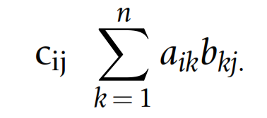
Vectors and Matrices
Matrix Multiplication
Getting Started with MATLAB / 2. General MATLAB Functions, Matrices and Determinants/ V.Naeini

Slide 31
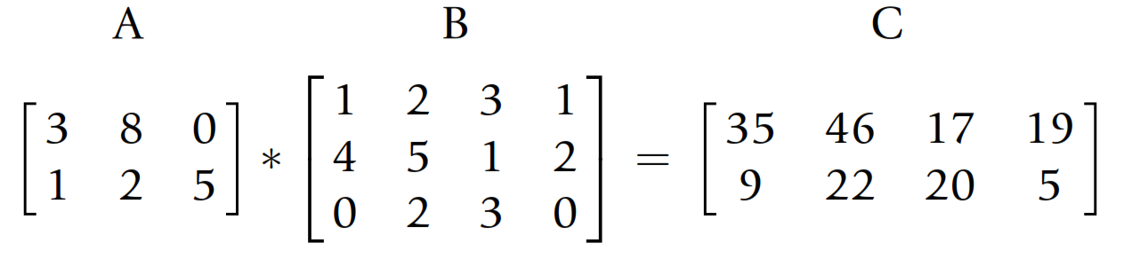
Vectors and Matrices
Matrix Multiplication
Getting Started with MATLAB / 2. General MATLAB Functions, Matrices and Determinants/ V.Naeini

Slide 32
Practice ☺
Define two square matrices (A and B) and calculate the following:
A.*B
A*B
B*A
Getting Started with MATLAB / 01. An Introduction / V.Naeini

Slide 33
Vectors and Matrices
Vector-Vector Multiplication
Matrix-Vector Multiplication
Vector-Matrix Multiplication
Getting Started with MATLAB / 2. General MATLAB Functions, Matrices and Determinants/ V.Naeini

Slide 34
Vectors and Matrices
Logical Vectors
>> vec = [5 9 3 4 6 11];
>> isg = vec > 5
isg =
0 1 0 0 1
>> vec(isg)
ans =
9 6 1
Getting Started with MATLAB / 2. General MATLAB Functions, Matrices and Determinants/ V.Naeini

Slide 35
Vectors and Matrices
Logical Vectors/matrices
>> false(2)
ans=
0 0
0 0
>> true(1,5)
ans =
1 1 1 1 1
Q: What’s the difference between zeros(2) and false(2)
Getting Started with MATLAB / 2. General MATLAB Functions, Matrices and Determinants/ V.Naeini

Slide 36
Vectors and Matrices
any and all
any:
returns logical true if any element in a vector represents true
all:
all returns logical true only if all elements represent true
>> isg = logical([0 1 0 1 1])
>> any(isg)
>> all(isg)
Getting Started with MATLAB / 2. General MATLAB Functions, Matrices and Determinants/ V.Naeini

Slide 37

Vectors and Matrices
“In the suitcase on the left
You'll find() my favorite axe”
Pink Floyd – One Of My Turns
Getting Started with MATLAB / 2. General MATLAB Functions, Matrices and Determinants/ V.Naeini

Slide 38
Vectors and Matrices
find()
>> vec = [5 3 6 7 2]
>> ﬁnd(vec > 5)
>> [r c] = find(…)
>> [r c v] = find(…)
Getting Started with MATLAB / 2. General MATLAB Functions, Matrices and Determinants/ V.Naeini

Slide 39
Vectors and Matrices
>> vec1 = [1 3 -4 2 99];
>> vec2 = [1 2 -4 3 99];
>> vec1 == vec2
ans =
1 0 1 0 1
>> all(vec1 == vec2)
>> isequal(vec1,vec2)
Getting Started with MATLAB / 2. General MATLAB Functions, Matrices and Determinants/ V.Naeini

Slide 40
Question
If we have a vector vec that erroneously stores negative values, how can we eliminate those negative values?
>> vec = [11 -5 33 2 8 -4 25];
Answer:
>> neg = ﬁnd(vec < 0)
>> vec(neg) = []
OR
>> vec = [11 -5 33 2 8 -4 25];
>> vec(vec < 0) = []
Getting Started with MATLAB / 2. General MATLAB Functions, Matrices and Determinants/ V.Naeini

Slide 41
Vectors and Matrices
or and and operators that work elementwise for arrays:
>> v1 = logical([1 0 1 1]);
>> v2 = logical([0 0 1 0]);
>> v1 & v2
>> v1 | v2
>> v1 || v2
Getting Started with MATLAB / 2. General MATLAB Functions, Matrices and Determinants/ V.Naeini

Slide 42
Vectors and Matrices
The function diff returns the differences between consecutive elements in a vector.
>> diff([4 7 15 32])
>> mat = randi(20, 2,3)
>> diff(mat)
Getting Started with MATLAB / 2. General MATLAB Functions, Matrices and Determinants/ V.Naeini

Slide 43
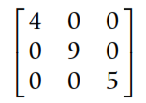
Matrix Solutions to Systems of Linear
Algebraic Equations
A linear algebraic equation is an equation of the form
diagonal matrix
>> mymat = reshape(1:16,4,4)‘
>> diag(mymat)’
Getting Started with MATLAB / 2. General MATLAB Functions, Matrices and Determinants/ V.Naeini

Slide 44
Matrix Solutions to Systems of Linear
Algebraic Equations
The diag function can be used two ways:
(i) pass a matrix and it returns a vector
(ii) pass a vector and it returns a matrix!
The trace of a square matrix is the sum of all of the elements on the diagonal.
>> trace(mymat)
Getting Started with MATLAB / 2. General MATLAB Functions, Matrices and Determinants/ V.Naeini

Slide 45
Matrix Solutions to Systems of Linear
Algebraic Equations
>>eye(n)
>> triu(mymat)
>> tril(mymat)
>>[L,U,P] = lu(A)
Getting Started with MATLAB / 2. General MATLAB Functions, Matrices and Determinants/ V.Naeini

Slide 46

Matrix Solutions to Systems of Linear
Algebraic Equations
For a square matrix
>> inv(a) %invert of matrix a
>> det(A) %determinant
Getting Started with MATLAB / 2. General MATLAB Functions, Matrices and Determinants/ V.Naeini

Slide 47
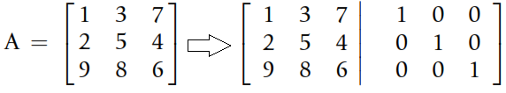
Matrix Solutions to Systems of Linear
Algebraic Equations
Matrix augmentation means adding column(s) to the original matrix.
>> A = [1 3 7; 2 5 4; 9 8 6]
>> augA = [A eye(size(A))]
Getting Started with MATLAB / 2. General MATLAB Functions, Matrices and Determinants/ V.Naeini

Slide 48
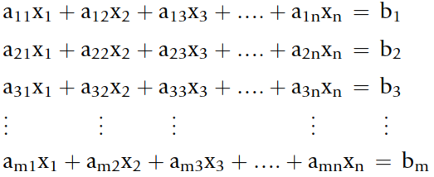
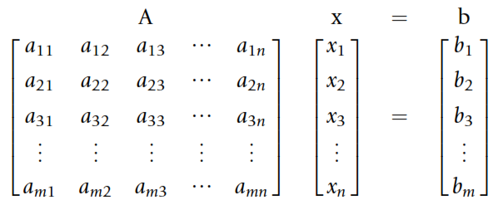
Matrix Solutions to Systems of Linear
Algebraic Equations
Getting Started with MATLAB / 2. General MATLAB Functions, Matrices and Determinants/ V.Naeini

Slide 49
Matrix Solutions to Systems of Linear
Algebraic Equations
>> A = [4 -2 1; 1 1 5; -2 3 -1];
>> b = [7;10;2];
Solve SLE:
>> x = inv(A)*b
>> x = A\b
Getting Started with MATLAB / 2. General MATLAB Functions, Matrices and Determinants/ V.Naeini

Slide 50
JUST SOLVE IT!
>> solve('4*x-2*y+z=7','x+y+5*z=10', ...
'-2*x+3*y-z=2')
ans =
x: [1x1 sym]
y: [1x1 sym]
z: [1x1 sym]
Getting Started with MATLAB / 2. General MATLAB Functions, Matrices and Determinants/ V.Naeini

Slide 51
JUST SOLVE IT!
>> X=ans.x
X =
124/41
>> Y=ans.y
Y =
121/41
>> Z=ans.y
Z =
121/41
Getting Started with MATLAB / 2. General MATLAB Functions, Matrices and Determinants/ V.Naeini

Slide 52


